Slide 1





Peer Review Essentials
February 20, 2024
Timothy G. Murray, MD, MBA, FASRS
Editor-in-Chief, JVRD
Section Editors:
Yoshihiro Yonekawa, MD, FASRS
Aleksandra Rachitskaya, MD, FASRS

Slide 2
Agenda
Overview of JVRD and review process
What makes a good reviewer?
Ethics
Rewards

Slide 3


JVRD Overview:
First issue launched: January, 2017
Indexed in PubMed Central: March, 2023
JVRD Podcast Series Launched: June, 2023

Slide 4
What is Peer Review?
The peer review process is essential to the development of research
Filters out poor quality articles
Assesses validity
Maintains integrity of science
We value the essential work of peer reviewers who ensure publication excellence and drive quality research.

Slide 5
Why Should You Review?
Help advance the field of retina
Stay current: be first to read cutting- edge research
Improve your research and writing skills
Authors and researchers benefit from having their papers improved and their knowledge expanded.

Slide 6
Types of Peer Review
Single blind peer review – the name of the reviewer is hidden from the author
Double blind peer review – names are hidden from both reviewers and the authors
Open peer review – everyone is identified

Slide 7
Basic Principles of Peer Review
Only agree to review manuscripts within your area of expertise that you can return in a timely manner
Respect the confidentiality of the process
Be objective and constructive in your review
Declare all conflicts of interests
Conflict of Interest
Personal, professional, or financial relationship with any party involved in the manuscript.

Slide 8
So, you’ve agreed to review…
now what?

Slide 9
Initial Impressions
Read the whole paper to get an initial impression before starting your in-depth review
Meeting basic standards:
Assure the paper is relevant for JVRD by checking the Aims & Scope
Does the paper give any indication of its quality threshold?
Is this research significant within the field?
Is the work novel? Is it original? Does it add to the subject area?
Note: It is not the reviewer’s job to proofread or suggest extensive grammatical revisions to a paper. If the meaning of the paper is lost due to extensive grammatical errors, recommend the paper for language editing.

Slide 10
Initial Impressions
Specifics to look for:
Does the title reflect the subject of the paper?
Do keywords reflect the content and are they up-to-date? For example, will keywords lure readers with a broad interest in the topic and at the same time reflect the more specific contents of the paper?
Is the paper an appropriate length? Sufficient number of references?
Does it read well? Are the key messages short and clear?

Slide 11
Initial Impressions
Examine the Results:
The authors should report the results of all tests noted in the methods:
Demographics – age, gender, site, etc.
Objective data
Subjective data
Complications of treatment
Ask yourself: do the numbers make sense?
Are the results clearly formatted and presented? Are SI units and other notations correct, and are graphs, axis headings, an data labels readable?
Look out for:
Major flaws in data, tables, figures and images
Insufficient data
Statistical variations
Unclear or contradictory data

Slide 12
Initial Impressions
Review the Discussion:
This should not be a repetition of the results, it should put the results of the study in context, i.e. how does it fit in with what we already know?
Do the authors achieve the aim stated in the introduction?
Have they cited all relevant/important published papers?
Can you follow the reasoning of the paper?
The authors should compare their data with previous published studies to:
Confirm similarities (i.e. validate the study further)
Explain differences

Slide 13
Individual Sections
Abstract:
After reading the abstract, you should understand the objective, key data and conclusion of the manuscript. If you don’t, make a note of it.
Introduction
Is it clear, short and simple?
Does it set the scene (i.e. explain the background of the study)?
Does it set out and justify the aim of the study?
Does the literature review include the latest research?

Slide 14
Individual Sections
Methods:
Academic research should be rigorous and replicable – are all relevant details included in this section?
Have all necessary procedures been followed (for example, Institutional Review Board or IRB)?
Are the methods appropriate?
Is it methodologically sound?
Is the author’s theory or argument credible?

Slide 15
Individual Sections
Conclusion:
Finally, authors should describe:
Limitations of the study
Take-home messages as a short conclusion
Considerations:
Does the conclusion address the questions posed? Is it consistent with the evidence and arguments presented?
Is the conclusion contradicted by the author’s evidence?
Does it correctly reference previously relevant work?
If the paper is not suitable as submitted, is it worth developing?

Slide 16
Your Feedback
Give advice to authors and suggest revisions
Demonstrate that you have read the paper.
Be objective, specific and constructive.
Be clear about what needs to be added or revised.
Give clear and detailed comments to the editor.
The review template will ask for two separate comments, one that is confidential to the editors and will not be shared, and the second which contains comments that will be shared the authors.
If appropriate, make suggestions about additional literature that the author might read to improve their manuscript.

Slide 17
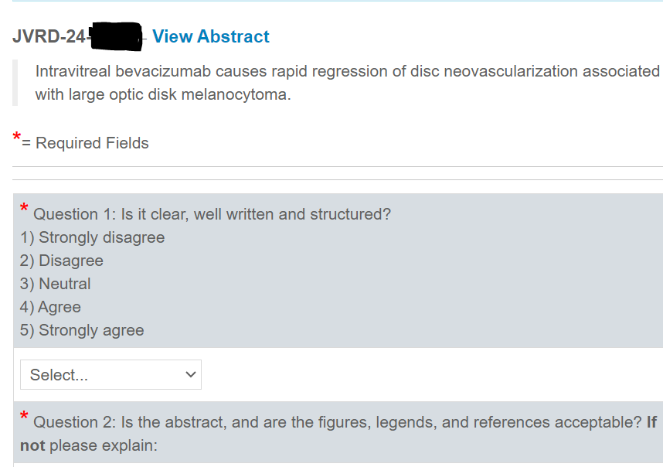
JVRD Review Example:

Slide 18
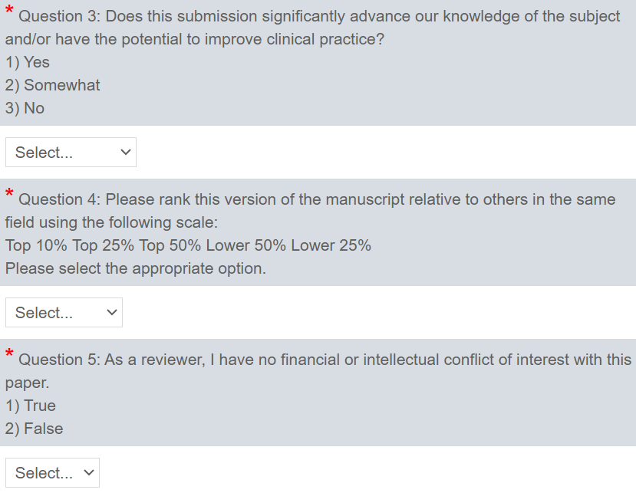
JVRD Review Example:

Slide 19
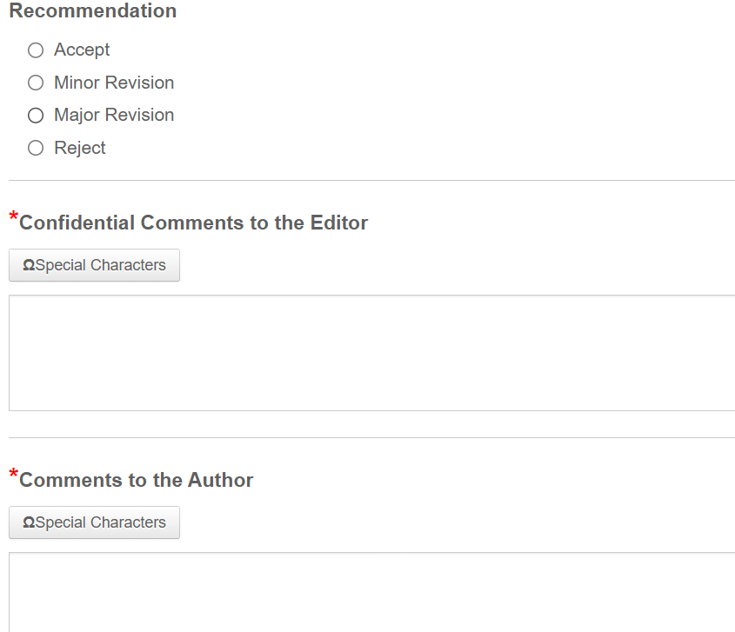
JVRD Review Example:
Be as specific and detailed as you can; brief comments to an Editor will not help them make a decision.
Tip:
Number your comments – this will make it easier for you to find, and for the editor to read through.

Slide 20
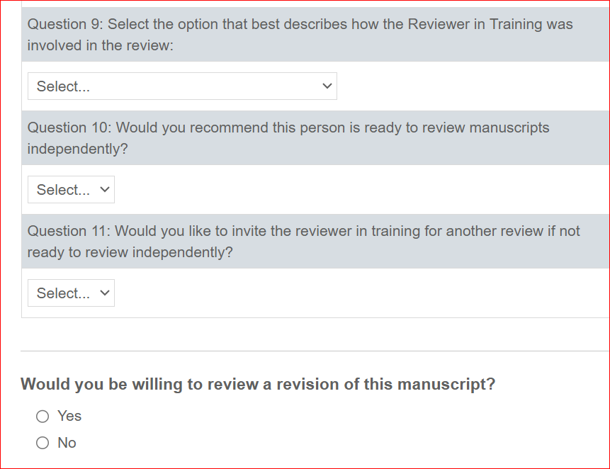
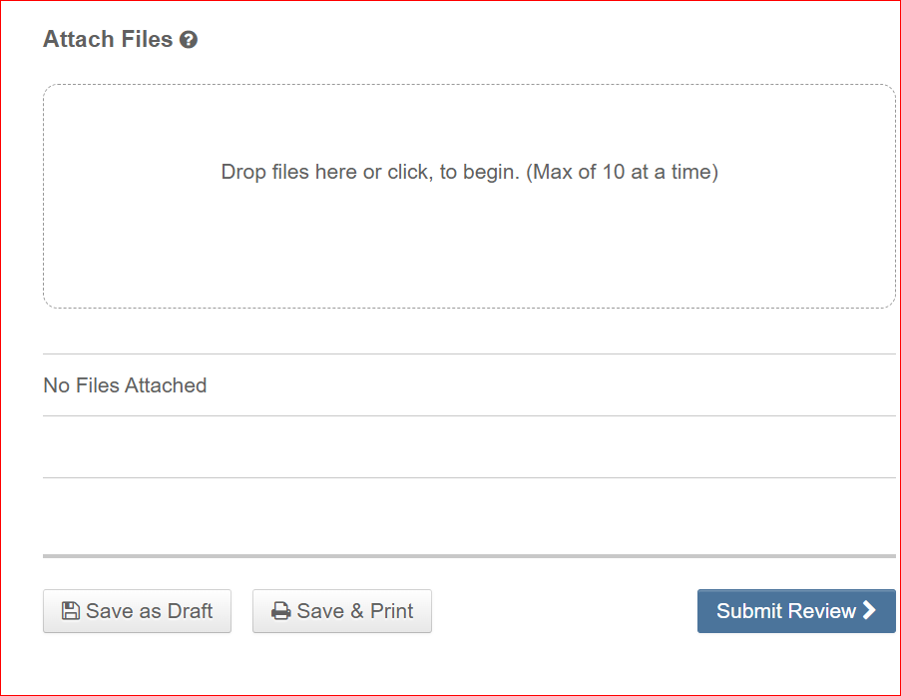
JVRD Review Example:

Slide 21
Making a recommendation
We will ask you to recommend whether a paper should be accepted, rejected or revised (major or minor revisions), and you may be asked to look over the changes made to a paper to ensure that improvements have been adequately made.
Have an overall view of the quality of the paper and consider if it is good enough to be published in the journal.
Remember: Keep all activity, content, and comments relating to the paper confidential

Slide 22
Making a recommendation
Issues to consider:
Are there major flaws, i.e. factual errors?
Is language assistance needed to enhance readability?
Are there problems with the presentation of the data or arguments?
Is any of the information unclear or ambiguous?
Has similar work been published?
Are there ethical issues?

Slide 23
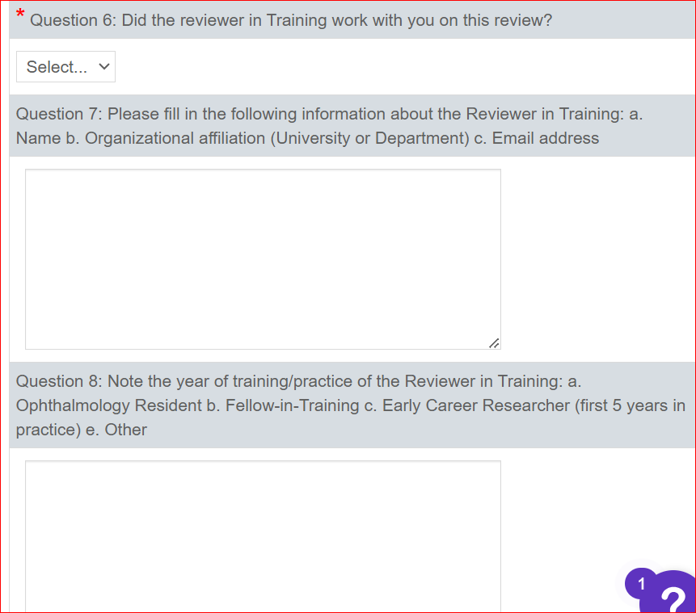
Reviewer-in-Training Mentoring Initiative:

Slide 24
Reviewer-in-Training Mentoring Initiative:

Slide 25
What makes a good reviewer?
Consider:
  Turnaround times
  Assessment of science
  Looking at the number and quality of tables, figures, references
  Quality of English

Slide 26
What makes a good reviewer?
Provides an overview of paper’s suitability for publication
Offers substantial and detailed feedback
Comments are easy to read and understand and in logical order
Specifies edits required
Points out good as well as bad (helps authors with their revisions)

Slide 27

What makes a reviewer «ineffectual»?
Lacks detail
Doesn’t justify decisions
Recommendations don’t reflect comments
Descriptive with no evaluation of content

Slide 28
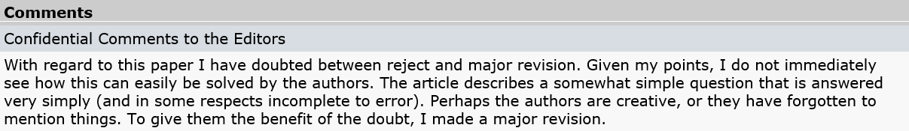
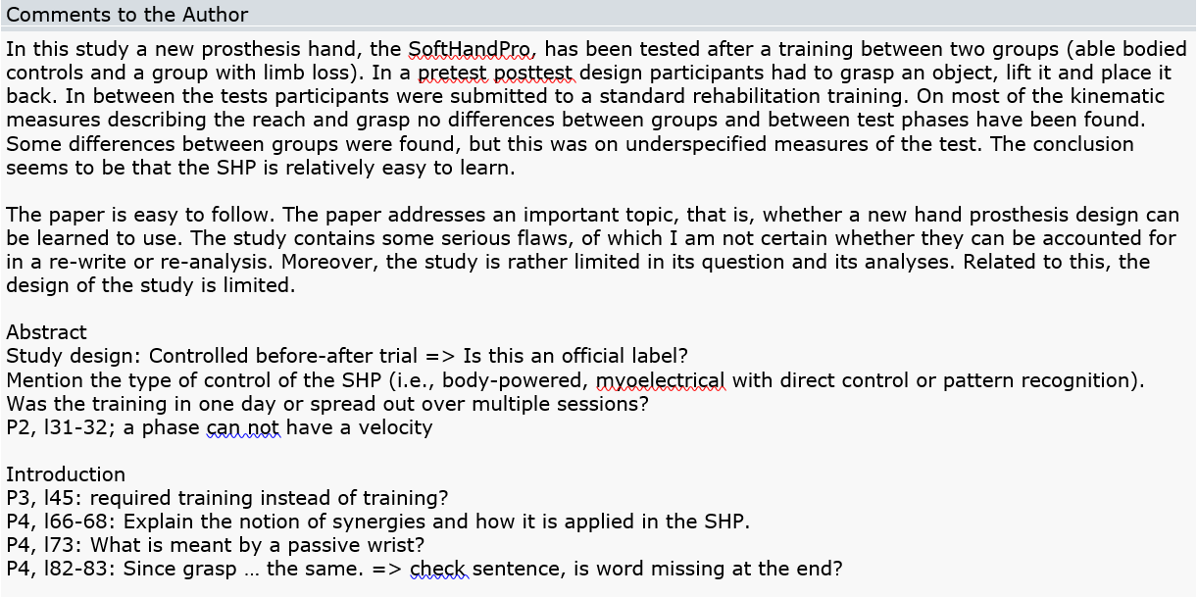
What Does a Good Review Look Like?
Provides a recommended decision and backs it up
Summarizes the paper
Provides both positive and constructive feedback to author
Provides specific feedback on individual sections using page numbers and lines

Slide 29
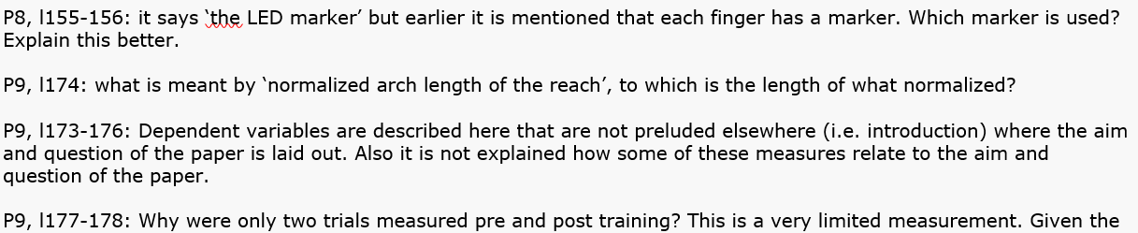
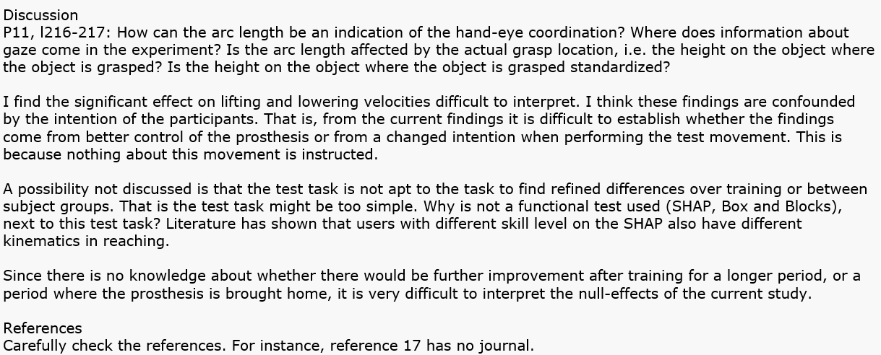
Provides specific feedback on individual sections using page numbers and lines
Asks questions of the author; these will help with revisions to the paper
Clearly backs-up reason for recommended decision
Reviewer has carefully looked at references

Slide 30
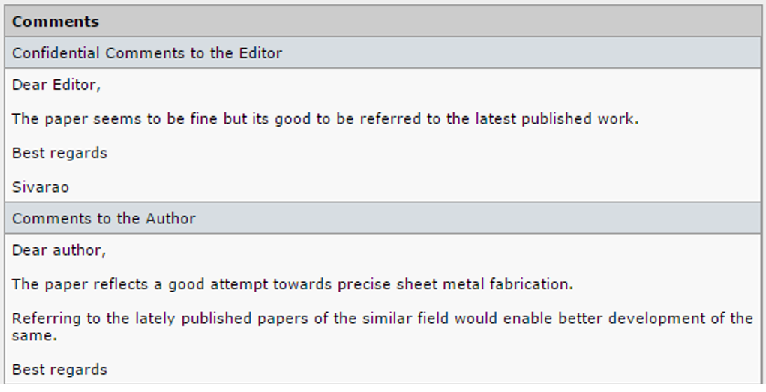
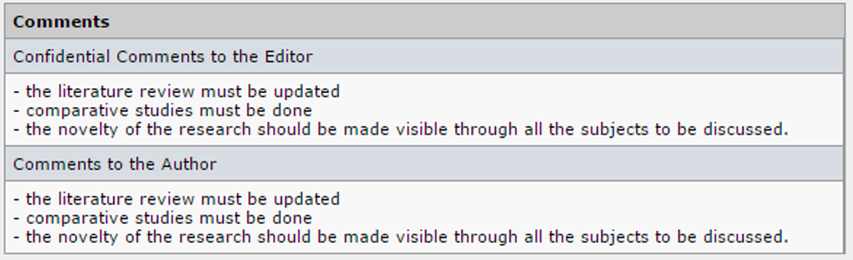
What Does an Ineffectual Review Look Like?
“Seems to be fine.”
Will this help the editor make a decision?
Does this show that the reviewer has actually read and understood the paper?
Is ‘fine’ an Accept?
How will this help the author revise their paper?
What would reflect a better attempt?
Are there any specific published papers the author should look at?
How will this help the editor make a decision?
How will this help the author revise the paper?
If you received this advice as an author, would you understand it? Would it be helpful?

Slide 31
Ethical Standards
Statement of Informed Consent
The patient gave verbal informed consent, which was documented in the authors’ personal records, to allow the use of his clinical findings and diagnostic imaging to be included in this report.
Declaration of Conflicting Interests
The author(s) declared no potential conflicts of interest with respect to the research, authorship, and/or publication of this article.
Funding
The author(s) received no financial support for the research, authorship, and/or publication of this article

Slide 32
Ethical Standards
Make sure you are familiar with the standards of research and reporting. Be sure to read the JVRD Author Guidelines, which outline standards authors must adhere to.
If the paper has failed to adhere to best practice standards, it does not require further review and should be rejected.

Slide 33
Ethical Considerations:
As you are reviewing a paper you may spot or suspect something that could constitute misconduct. Contact the editor if you suspect any of the following problems with any article you are reviewing:
The paper has been either published or submitted to another journal.
The paper is duplicating the work of others.
There might be problems with the ethics of the research conducted.
There might be an undeclared conflict of interest attached to the paper/
You should keep all information about such matters confidential and not discuss them with colleagues.

Slide 34
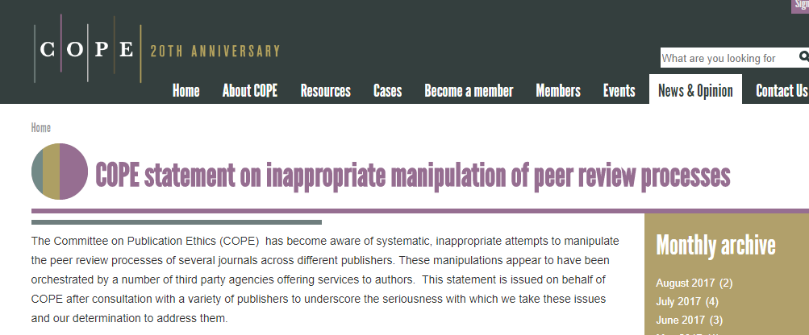
Reviewer Fraud
We know that the vast majority of authors, editors and reviewers act in good faith and hold themselves to the highest ethical standards.

Slide 35
Reviewer Rewards
ASRS members who wish to apply for the FASRS credential get 1 point for reviewing 3 or more submissions to JVRD with a limit of 2 points in any calendar year.
We are grateful for the support of all of our reviewers in helping authors to enhance and develop their papers.

Slide 36
Questions?
Jennifer.Carstens@asrs.org
Sameer.Grover@sagepub.in

Slide 37
Thank You
A webinar recording will be posted to the ASRS website
and the SAGE publishing site as a resource.

